Slide 1
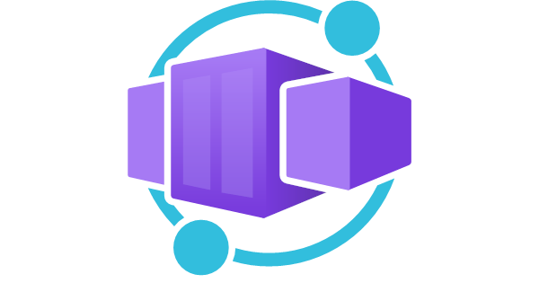
Azure Container Apps
Luke Murray

Slide 2
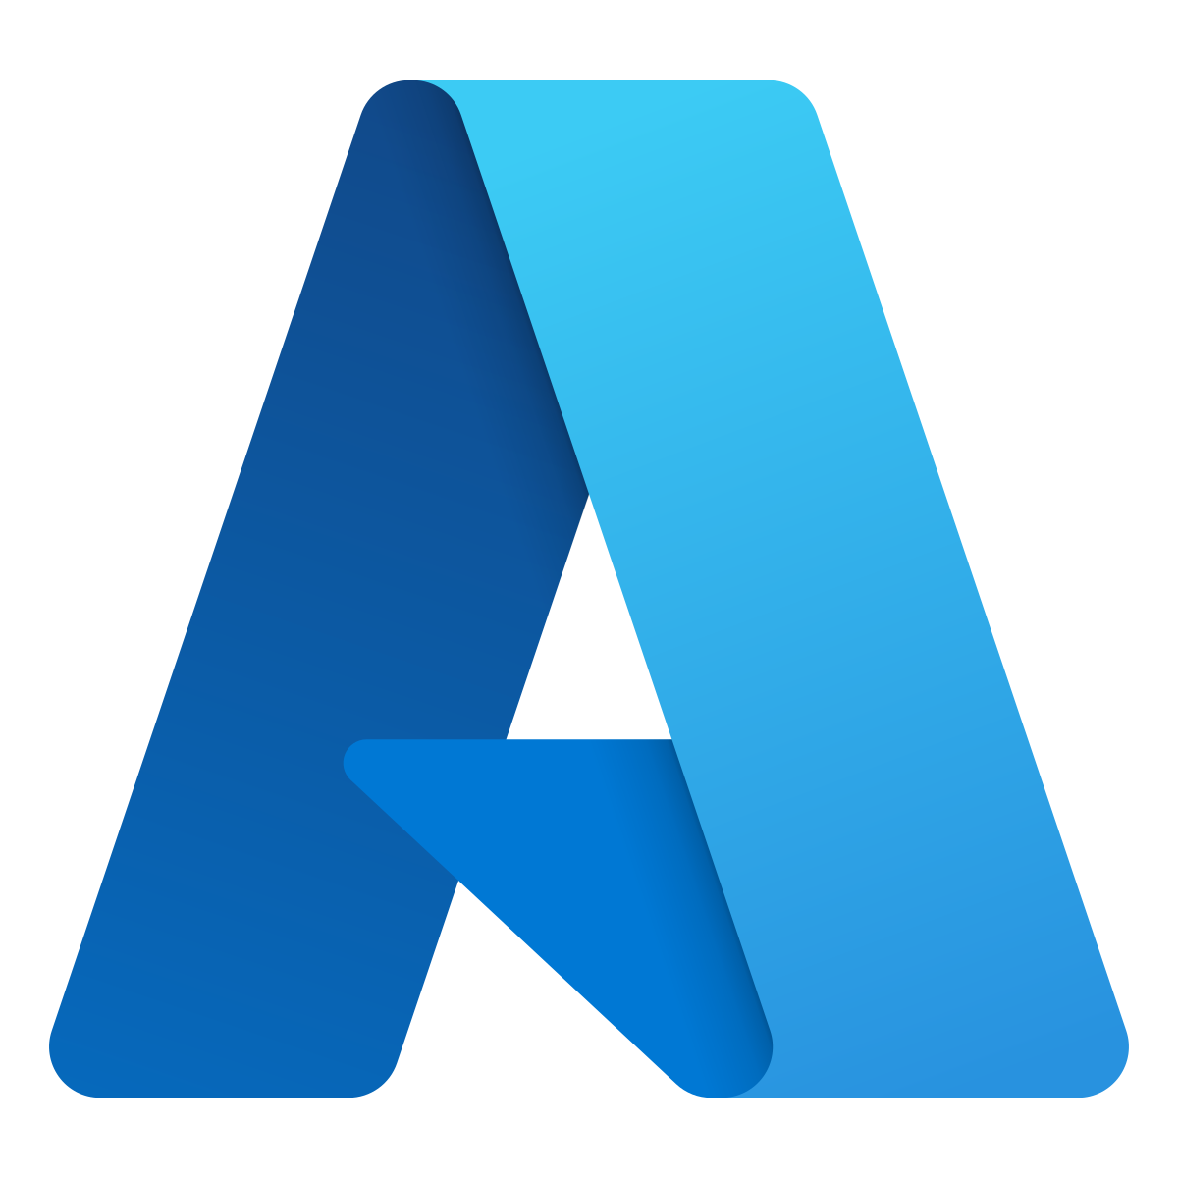
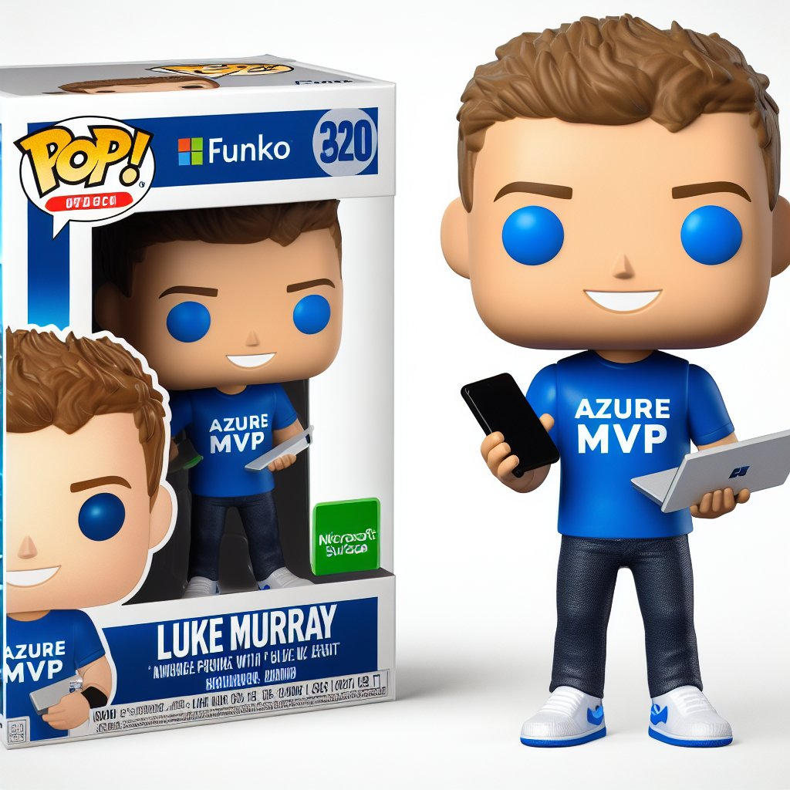
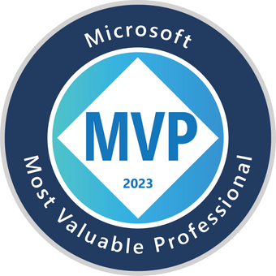


So, who am I?
My name is Luke Murray
He/Him
Senior Consultant in Hamilton, New Zealand.
Feel free to reach out on Social Media, if you need any help: https://linktr.ee/lukemurray
Introduction
Azure Cloud
Commanders

Slide 3
“Azure Container Apps is a fully managed Kubernetes-based application platform that helps you deploy apps from code or containers without orchestrating complex infrastructure.”

Slide 4
Understanding Azure Container Apps
KEEP
CONTAINERS CALM
AND
PUT IT IN AZURE

Slide 5
Azure Container Apps is a fully managed serverless container service for building and deploying modern apps at scale

Slide 6
Monoliths, Microservices and Containers? Huh?

Slide 7
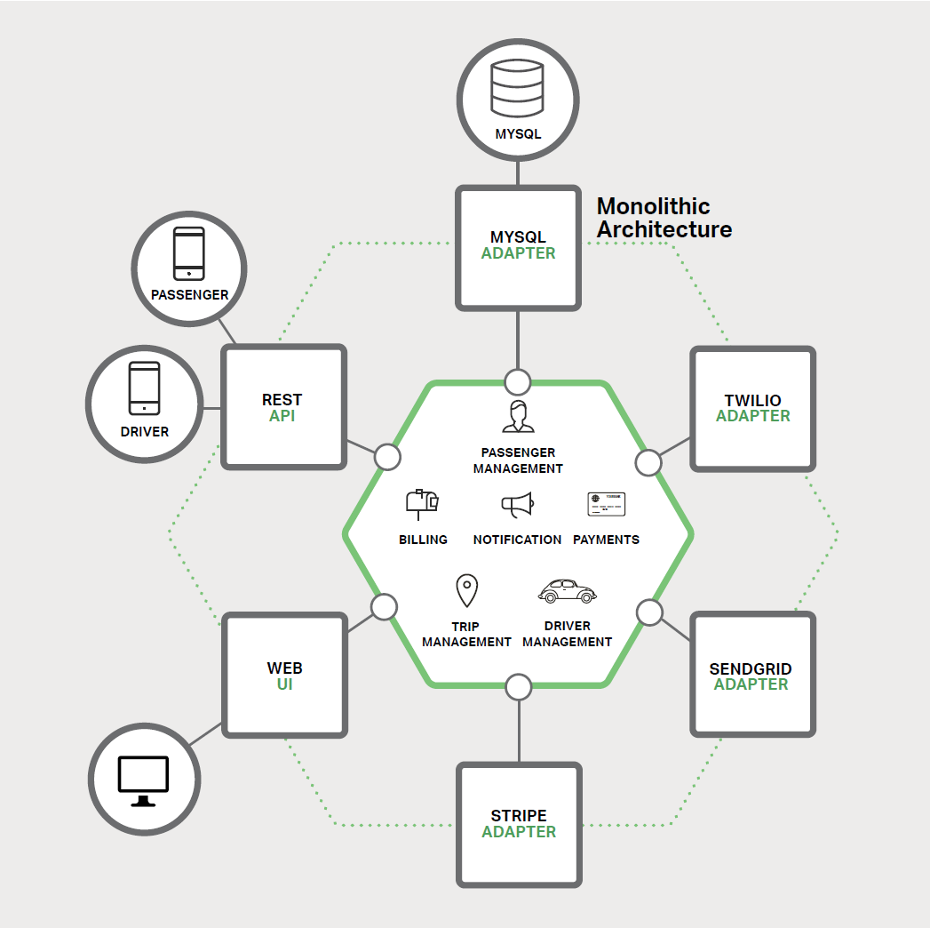
What is a Monolith?
Most applications built in the last 15 years
A large application core, composed of a single key technology
Typically surrounded by a layer of adapters that expose its functionality to the outside world and provide access to dependencies

Slide 8
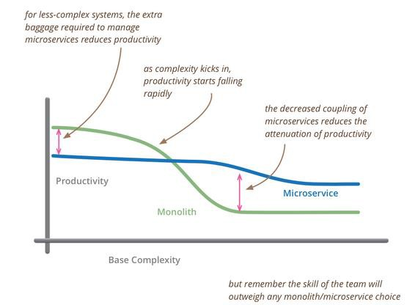
Shortcomings of the Monolith
Over time, application complexity grows, causing applications to grow stale and clunky.

Slide 9
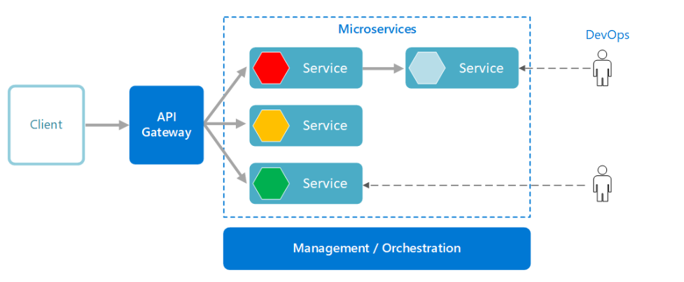
What are Microservices?
An approach to application development
Large application built around a collection of services
Distributed architecture

Slide 10
Microservices and Containers
Microservices
Containers
A large application core, composed of a single key technology
Typically surrounded by a layer of adapters that expose its functionality to the outside world and provide access to dependencies
Commonly deployed in containers
Provide fine-grained execution environment
Provide a high degree of isolation
Provide fast initialization and execution
Leverage orchestrators to manage microservice-based apps
Using container tools, help simplify complexities inherent in applications

Slide 11
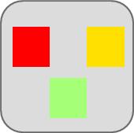

Traditional application approach
Microservices application approach
App 1
A traditional application has most functionality within a few componentized processes with layers and libraries.
Scales by cloning the app on multiple servers/VMs
A microservice application segregates functionality into separate smaller services.
Scales out by deploying each service independently with multiple instances across servers/VMs
App 1
App 2 2
Independent deployment and scale of microservices
Coarse-grained density of apps/services
Fine-grained density of services
Need to deploy and scale the full application

Slide 12
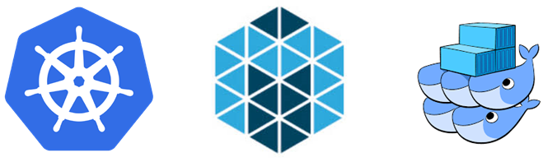
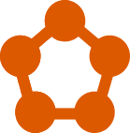
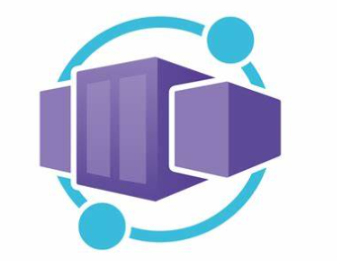
Why Container Orchestration?
Container orchestration is required to transition from deploying containers individually on a single host, to deploying complex multi-container apps on many machines. It requires a distributed platform, independent from infrastructure, that stays online through the entire lifetime of your application, surviving hardware failure and software updates.
Some of the main Container Orchestration Platforms:
Kubernetes (Descended from a platform (Borg) that Google developed to manage its infrastructure, Kubernetes is well suited for very large cloud environments)
Mesos
Docker Swarm
Azure Service Fabric
Azure Container Apps

Slide 13
What is Container Orchestration?
Container orchestration is all about managing the lifecycles of containers, especially in large, dynamic environments. Container orchestration engines manage how multiple containers are created, upgraded, and made highly available.
The elements of orchestration
Scheduling
Affinity/anti-affinity
Health monitoring
Failover
Scaling
Networking
Service discovery
Coordinated app upgrades

Slide 14
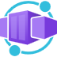
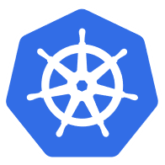



Queue.. Container Apps!
Azure Container Apps
Serverless containers for microservices
Build modern apps on open source
Focus on apps, not infrastructure
Seamlessly port to Kubernetes
Kubernetes
KEDA
DAPR
Envoy

Slide 15
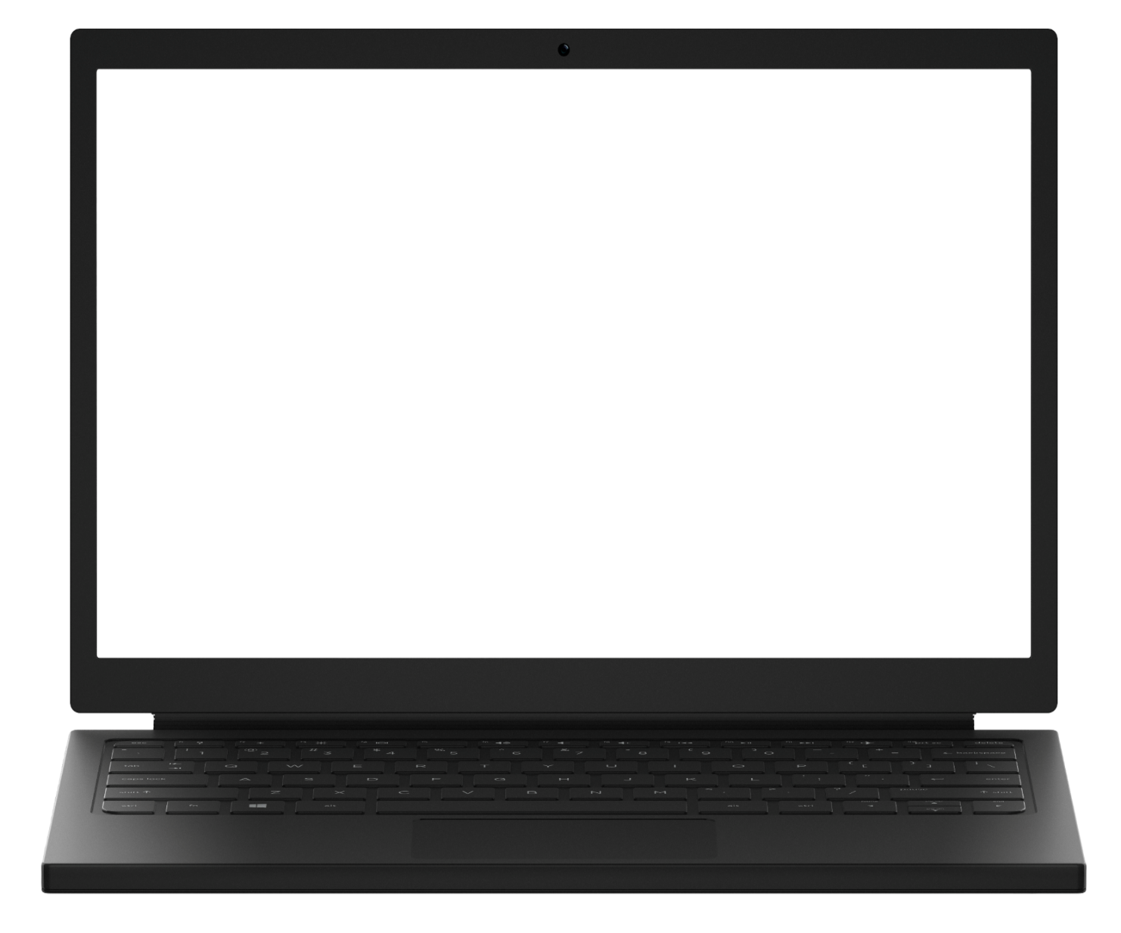
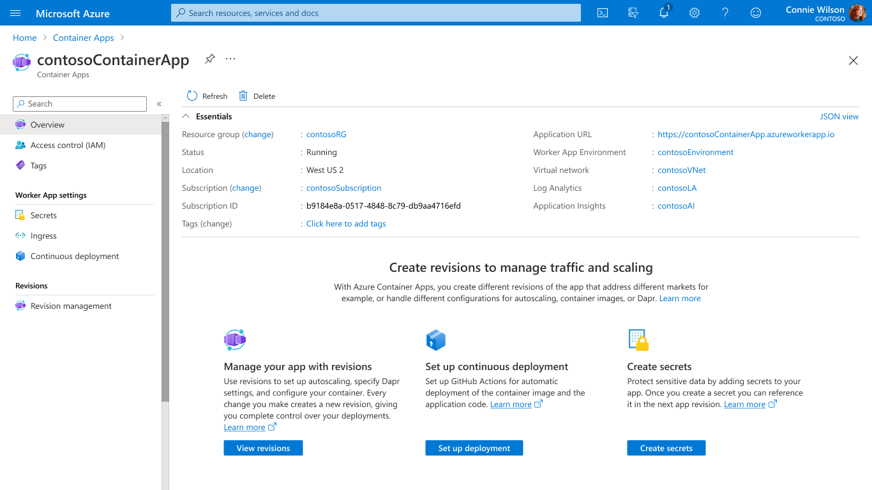
Run containers, at scale
Accelerate developer productivity
Build modern apps on open-source
Scale with flexible serverless containers
Run containers and scale in response to HTTP traffic or a growing list of KEDA-supported scale triggers including Azure Event Hub, Apache Kafka, RabbitMQ Queue, MongoDB, MySQL, and PostgreSQL
Get robust autoscaling capabilities without the overhead of managing complex infrastructure.
Scale to zero and pay for only what you use, by the second.

Slide 16
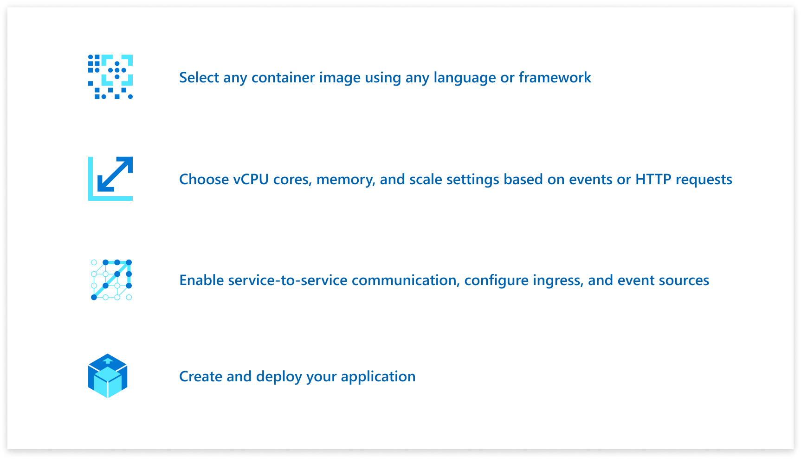
Run containers, at scale
Accelerate developer productivity
Build modern apps on open-source
Accelerate developer productivity
Build microservices, APIs, event processing workers, and background jobs using containers.
Write code in your favorite programming language and accelerate development with built-in Distributed Application Runtime (Dapr) integration to simplify common tasks like event processing, pub/sub, and service invocation.
Set up a code-to-cloud pipeline using GitHub Actions.

Slide 17
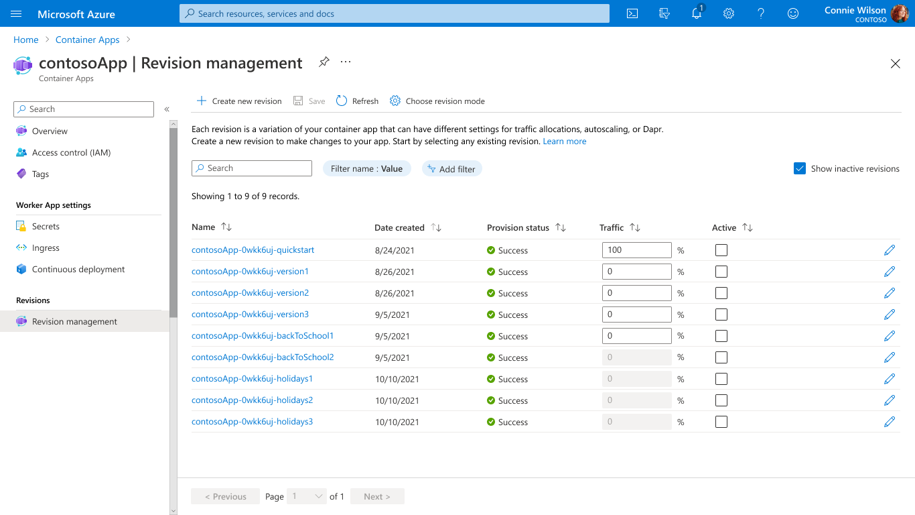
Run containers, at scale
Accelerate developer productivity
Build modern apps on open-source
Build modern apps on open-source
Create modern apps with open standards on a Kubernetes foundation and portability in mind.
Contribute directly to OSS projects to influence product capabilities.
Rely on streamlined application lifecycle tasks such as application upgrades and versioning, traffic shifting, service discovery, and monitoring.

Slide 18
What can you build with Azure Container Apps?
Public API endpoints
Web
Apps
Event-driven processing
Background processing
Microservices
MICROSERVICE A
MICROSERVICE B
HTTP TRAFFIC
MICROSERVICE C
80%
20%
REVISION 1
REVISION 2
Microservices architecture with the option to integrate with Dapr
E.g., API app with HTTP requests split between two revisions of the app
E.g., Web app with custom domain, TLS certificates, and integrated authentication
E.g., Queue reader app that processes messages as they arrive in a queue
E.g., Continuously running background process transforms data in a database
AUTO-SCALE CRITERIA
Individual microservices can
scale independently using any KEDA scale triggers
Scaling is determined by the number of concurrent HTTP requests
Scaling is determined by the number of concurrent HTTP requests
Scaling is determined by the number of messages in the queue
Scaling is determined by the level of CPU or memory load

Slide 19
What are the differences between Azure Container Apps and other Container solutions?

Slide 20
Azure Kubernetes Service and Azure Container Apps
Azure customers can easily deploy microservices using either Azure Kubernetes Service for flexible customized container solutions, or Azure Container Apps for productivity-optimized fully-managed serverless container solutions. Azure delivers app portability to support business growth powered by open-source in the Kubernetes ecosystem.
Cloud Native App Portability
Develop cloud native apps with open standards and APIs (e.g., Dapr) and port across Azure Container Apps and Azure Kubernetes Service.
Leverage Azure Container Apps guidance and tooling to port cloud native apps to Azure Kubernetes Service
Azure Container Apps is composed entirely of open-source components available to build your own Azure Kubernetes Service solution.

Slide 21

How managed Kubernetes on Azure works
Automated upgrades, patches
High reliability, availability
Easy, secure cluster scaling
Self-healing
API server monitoring
At no charge
Azure managed control plane
App/ workload definition
Self-managed master node(s)
Kubernetes API endpoint
etcd Store
User
API server
Scheduler
Controller Manager
Cloud Controller
Schedule pods over private tunnel
Customer VMs
Docker
Docker
Docker
Docker
Docker
Pods
Pods
Pods
Pods
Pods

Slide 22
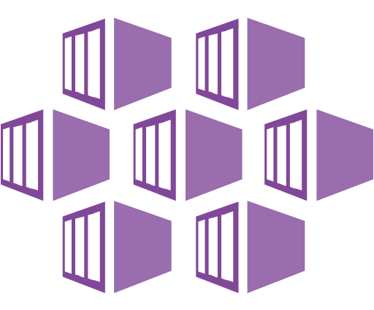
How does ACA compare to AKS?
Azure Kubernetes Service (AKS)
Azure Container Apps (ACA)
Infrastructure focus, higher flexibility
Application focus, infrastructure abstraction
Managed Kubernetes cluster in Azure with full access to the Kubernetes API server and high level of control over cluster configuration with a node-based pricing model
Fully-managed serverless abstraction on top of Kubernetes infrastructure, purpose built for managing and scaling event-driven microservices with a consumption-based pricing model
Core value proposition
Upstream Operations flexibility with advanced customization
m feature parity with a managed control plane
Experienced Kubernetes operators
Platform-as-a-Service experience with serverless scale
Developer productivity with low operations overhead
Linux-based, general-purpose stateless containers
Optimized for
Operators deploy node-based AKS clusters using Azure Portal, CLI or Infrastructure-as-Code templates (IaC)
Developers deploy containers via Kubernetes deployment manifests or HELM charts to logically-isolated namespaces within the cluster
Developers deploy containers as individual Container Apps using Azure Portal, CLI or IaC templates without any Kubernetes manifests required
Related container apps are deployed to a shared Container Apps environment comparable to a Kubernetes namespace
Interaction model
Provides a set of cluster extensions and add-ons for operators to enable OSS components in-cluster including Dapr, KEDA, Open Service Mesh, GitOps (Flux), Pod Identity, etc.
Supports manual installation via Kubernetes manifests
Includes opinionated platform capabilities powered by CNCF projects including Dapr, KEDA and Envoy which are fully platform-managed and supported
Envoy: managed ingress and traffic splitting
KEDA: managed, event-driven autoscale
Dapr: codified best practices for microservices
OSS Integration

Slide 23
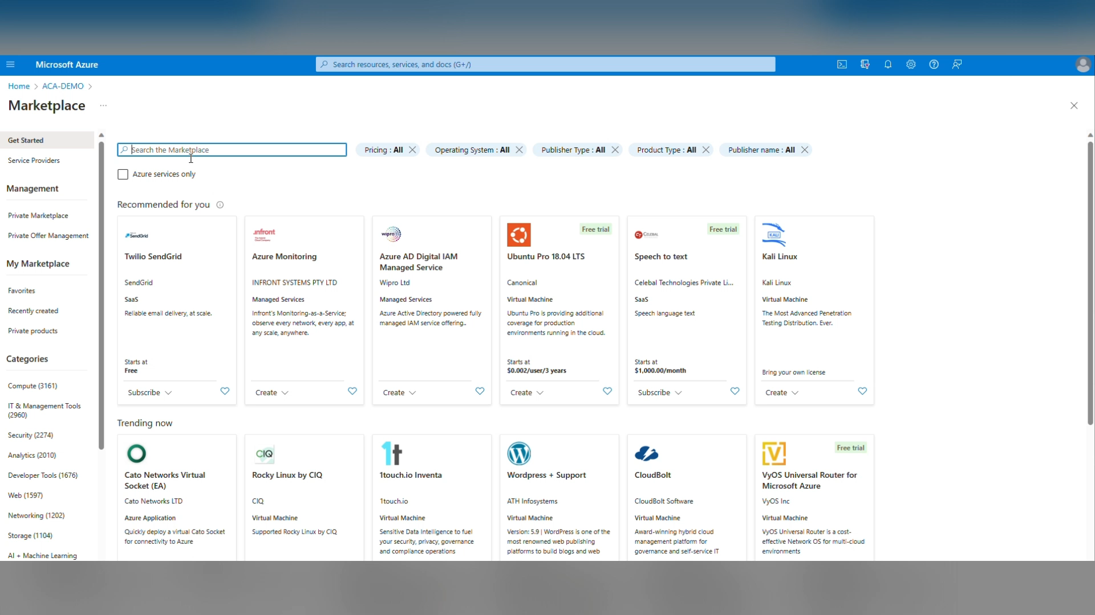
ACA Portal deployment -demo

Slide 24
KEEP
CONTAINERS CALM
AND
PUT IT IN AZURE
Building
Container Apps

Slide 25
Azure container apps deployment options
Azure Portal Deployment
Azure cli deployment
ARM template deployment
Bicep template deployment
Terraform template deployment
Pulumi or other API tools
az containerapp | Microsoft Learn
Quickstart - create a container instance - Bicep - Azure Container Instances | Microsoft Learn
Microsoft.App/containerApps - Bicep, ARM template & Terraform AzAPI reference | Microsoft Learn

Slide 26
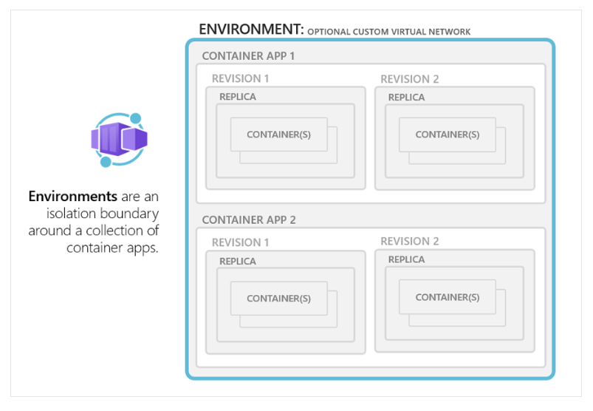
Building Azure container apps environment.
A Container Apps environment is a secure boundary around groups of container apps that share the same virtual network and write logs to the same logging destination.
Container Apps environments are fully managed where Azure handles OS upgrades, scale operations, failover procedures, and resource balancing.

Slide 27
Container app environment
Reasons to deploy container apps to the same environment :
Manage related services
Deploy different applications to the same virtual network
Instrument Dapr applications that communicate via the Dapr service invocation API
Have applications to share the same Dapr configuration
Have applications share the same log analytics workspace
Also, you may provide an existing virtual network when you create an environment.
Reasons to deploy container apps to different environments :
Two applications never share the same compute resources
Two Dapr applications can't communicate via the Dapr service invocation API

Slide 28
Billing for Azure Container Apps
Consumption only
Dedicated plan
If you're using the Consumption only plan, or only the Consumption workload profile in the Consumption + Dedicated plan structure then billing is relevant only to individual container apps and their resource usage. There's no cost associated with the Container Apps environment.
If you're using any Dedicated workload profiles in the Consumption + Dedicated plan structure, there's a fixed cost for the Dedicated plan management. This cost is for the entire environment regardless of how many Dedicated workload profiles you're using.

Slide 29
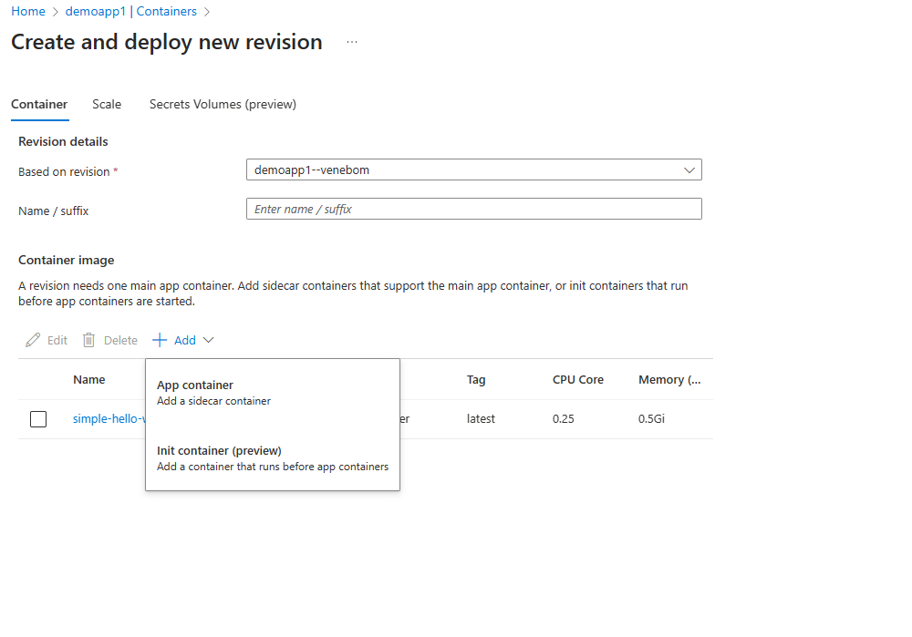
Multiple containers
App container
Init Container

Slide 30
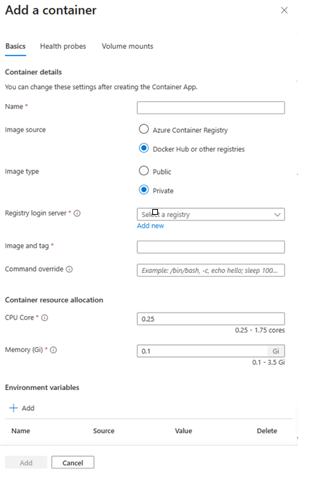
Container registries
Azure container registry
Docker Hub and other registries.
Public and Private

Slide 31
Walk through Azure container registry in Portal - Demo
https://portal.azure.com/

Slide 32
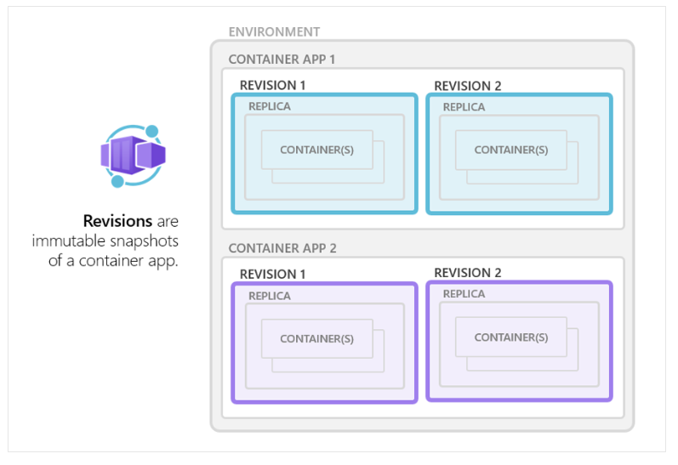
Understanding revisions in ACA
Azure Container Apps implements container app versioning by creating revisions. A revision is an immutable snapshot of a container app version.
The first revision is automatically provisioned when you deploy your container app.
New revisions are automatically provisioned when you make a revision-scope change to your container app.
While revisions are immutable, they're affected by application-scope changes, which apply to all revisions.
You can create new revisions by updating a previous revision.
You can retain up to 100 revisions, giving you a historical record of your container app updates.
You can run multiple revisions concurrently.
You can split external HTTP traffic between active revisions.

Slide 33
Environment (virtual network boundary)
Container app 1
Revisions
Revision 1
Revision 2
Pod
Pod
Pod
Pod
Revisions are immutable version snapshots of a container app
Container(s)
Container(s)
Container(s)
Container(s)
Container app 2
Revision 1
Revision 2
Pod
Pod
Container(s)
Container(s)

Slide 34
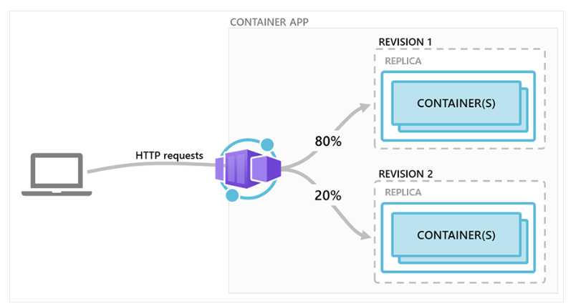
Multiple revisions - Scenario
This scenario presumes the container app is in the following state:
Ingress is enabled, making the container app available via HTTP or TCP.
The first revision was deployed as Revision 1.
After the container was updated, a new revision was activated as Revision 2.
Traffic splitting rules are configured so that Revision 1 receives 80% of the requests, and Revision 2 receives the remaining 20%.

Slide 35
Environment (virtual network boundary)
Container app 1
Containers
Revision 1
Revision 2
Pod
Pod
Pod
Pod
Containers in Azure Container Apps can use any and development stack of your choice
Container(s)
Container(s)
Container(s)
Container(s)
Container app 2
Revision 1
Revision 2
Pod
Pod
Container(s)
Container(s)

Slide 36
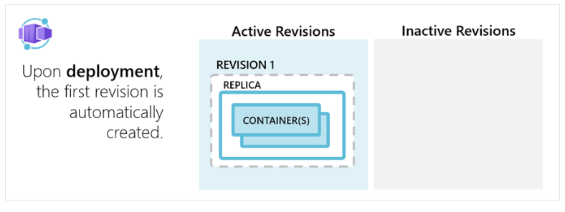
Application lifecycle management with ACA

Slide 37
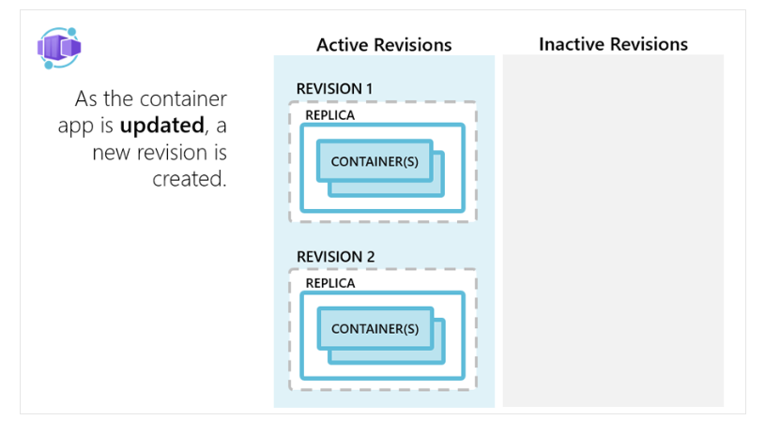
Application lifecycle management with ACA

Slide 38
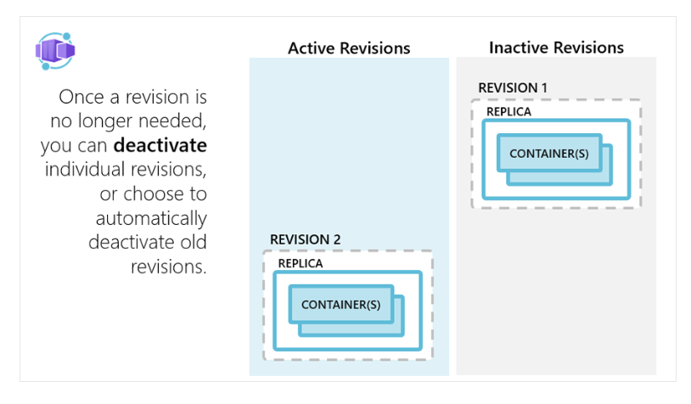
Application lifecycle management with ACA

Slide 39
"template": {
"containers": [
{
"image": "myregistry/myQueueApp:v1",
"name": "myQueueApp",
"env": [
{
"name": "QueueName",
"value": "myqueue"
},
{
"name": "ConnectionString",
"secretref": "queue-connection-string"
}
]
}
],
}
Secrets management
Securely store sensitive configuration elements that are then available to containers through environment variables, scale rules, and Dapr

Slide 40
Shutdown
The containers are shut down in the following situations:
As a container app scales in
As a container app is being deleted
As a revision is being deactivated
When a shutdown is initiated, the container host sends a SIGTERM message to your container. The code implemented in the container can respond to this operating system-level message to handle termination.
If your application doesn't respond within 30 seconds to the SIGTERM message, then SIGKILL terminates your container.
Additionally, make sure your application can gracefully handle shutdowns. Containers restart regularly, so don't expect state to persist inside a container. Instead, use external caches for expensive in-memory cache requirements.

Slide 41
Lab: 1
Exercise 1 - Deploy Backend API to ACA
Exercise 2 - Communication Between Microservices in ACA

Slide 42
KEEP
CONTAINERS CALM
AND
PUT IT IN AZURE
Understanding Dapr integration

Slide 43
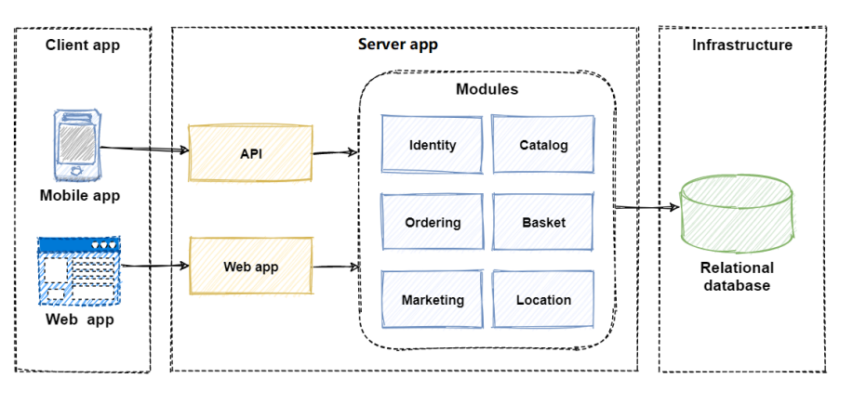
Dapr (distributed application runtime)
What is Distributed application ?
Why distributed application runtime is required ?
Monolithic application architecture

Slide 44
Monolithic application management overhead
The monolith has become so overwhelmingly complicated that no single person understands it.
You fear making changes as each brings unintended and costly side effects.
New features/fixes become time-consuming and expensive to implement.
Even the smallest change requires full deployment of the entire application - expensive and risky.
One unstable component can crash the entire system.
Adding new technologies and frameworks aren’t an option.
Implementing agile delivery methodologies are difficult.
Architectural erosion sets in as the code base deteriorates with never-ending “special cases.”
Eventually the consultants come in and tell you to rewrite it

Slide 45
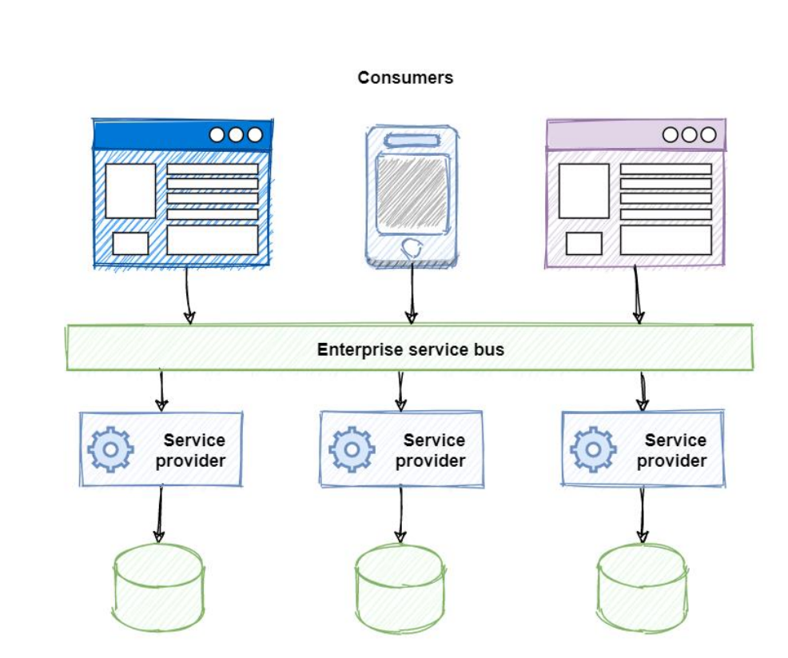
Service orientated architecture

Slide 46
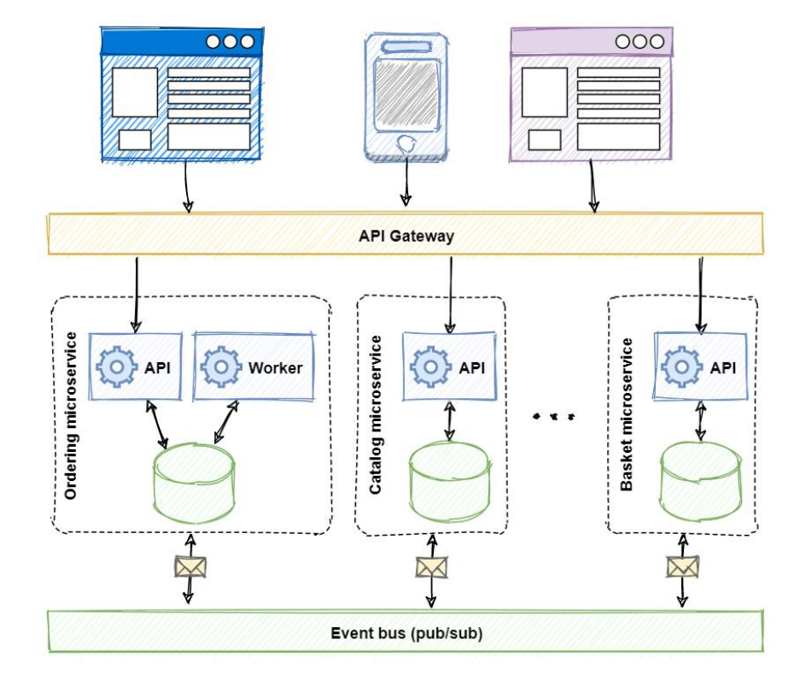
Dapr distributed architecture

Slide 47
Distributed architecture. How?
How can distributed services discover each other and communicate synchronously?
How can they implement asynchronous messaging?
How can they maintain contextual information across a transaction?
How can they become resilient to failure?
How can they scale to meet fluctuating demand?
How are they monitored and observed?

Slide 48
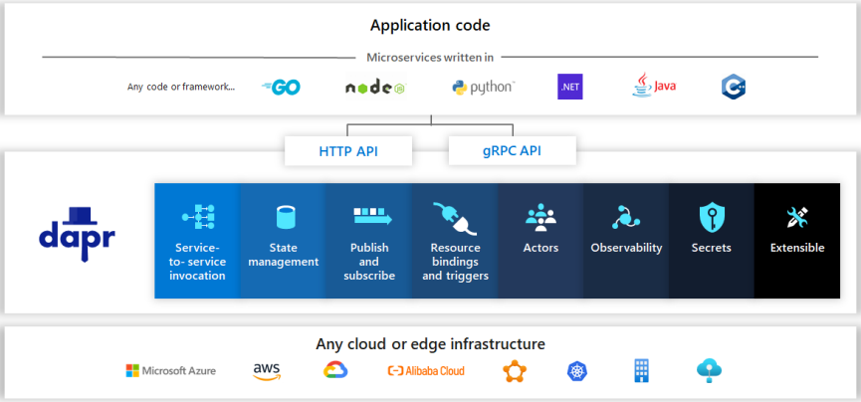
Dapr High-level overview
Dapr, or Distributed Application Runtime, is a new way to build modern distributed applications

Slide 49
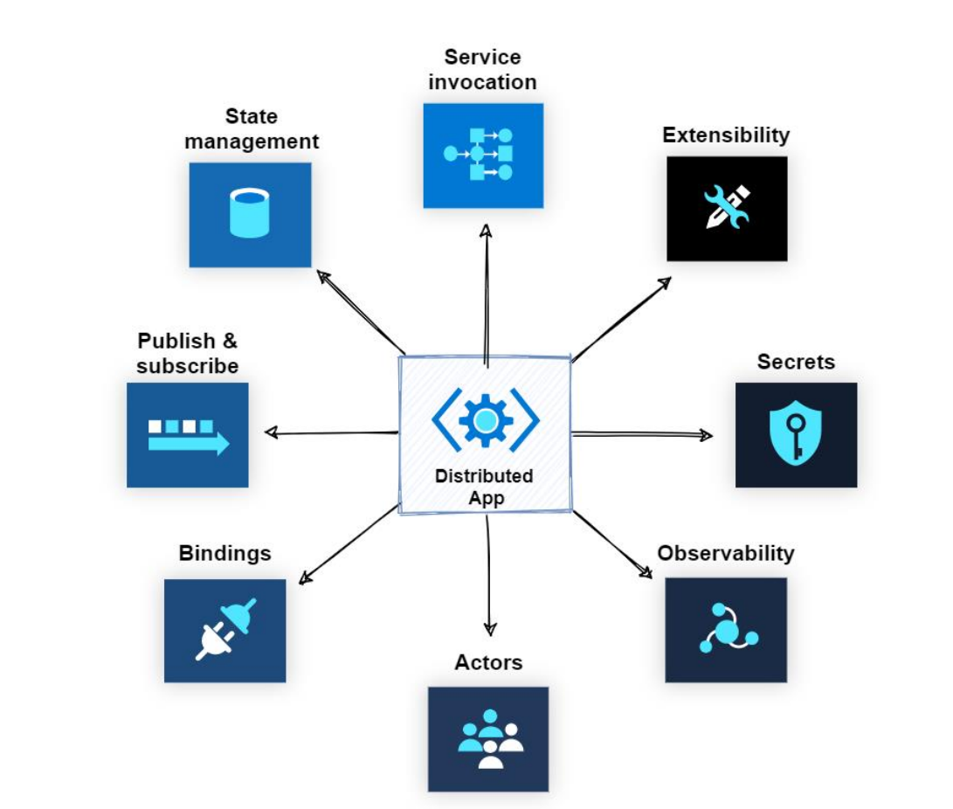
Dapr
Building
blocks

Slide 50
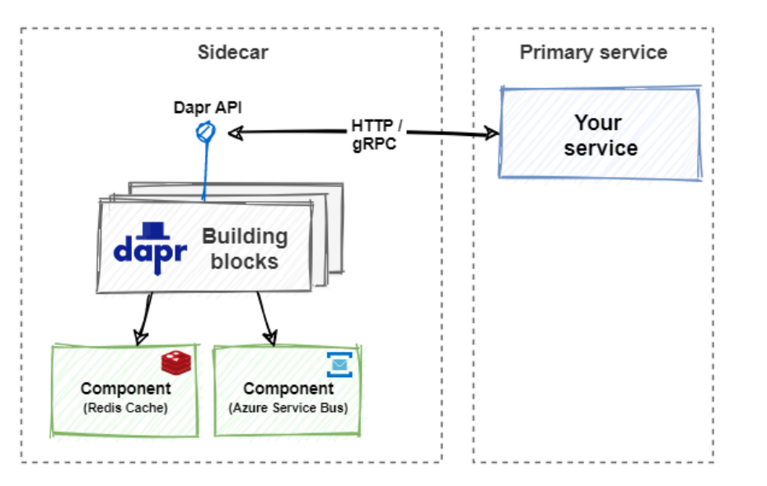
Sidecar architecture

Slide 51
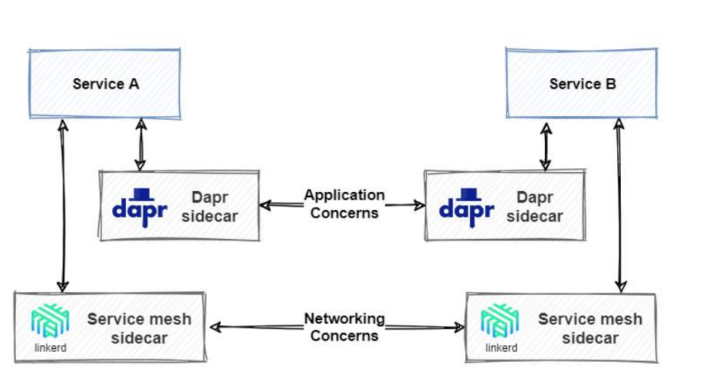
Dapr and Service mesh together

Slide 52
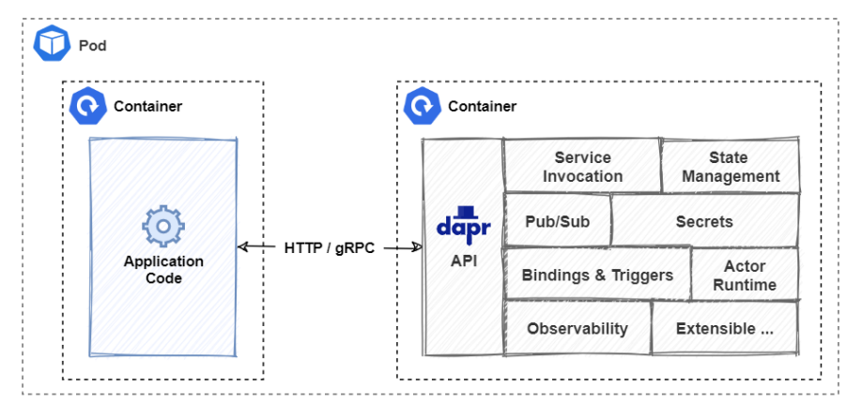
Dapr with Kubernetes

Slide 53
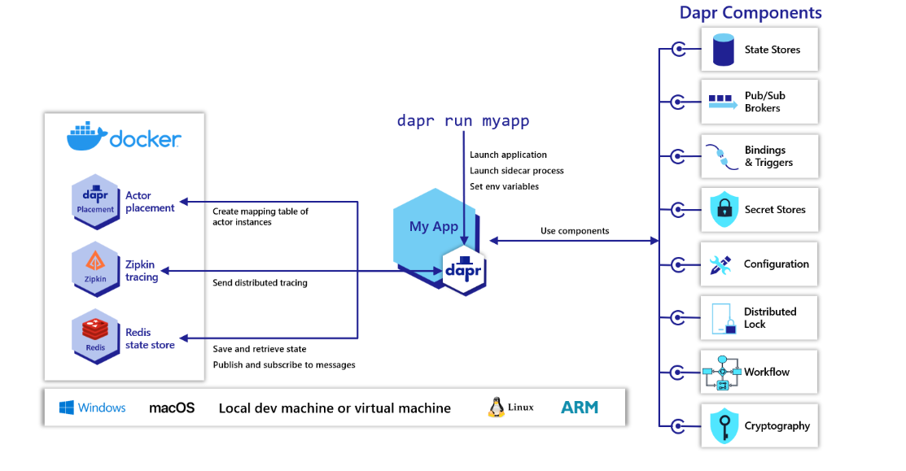
Dapr in self-hosted mode
Dapr can be configured to run in self-hosted mode on your local developer machine or on production VMs.
Each running service has a Dapr runtime process (or sidecar) which is configured to use state stores, pub/sub, binding components and the other building blocks. Overview of Dapr in self-hosted mode | Dapr Docs
How-To: Invoke services using HTTP | Dapr Docs

Slide 54
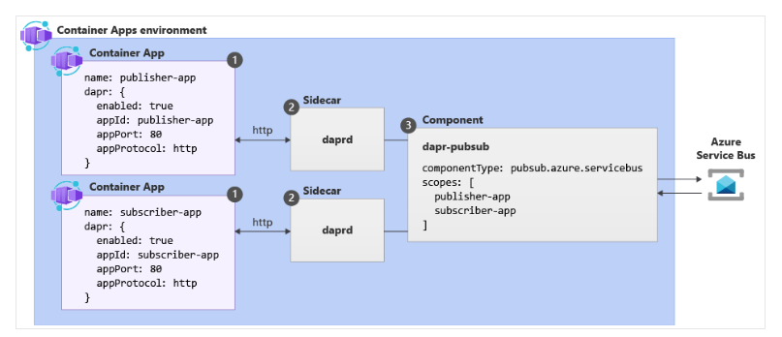
Finally, Dapr with Container Apps

Slide 55
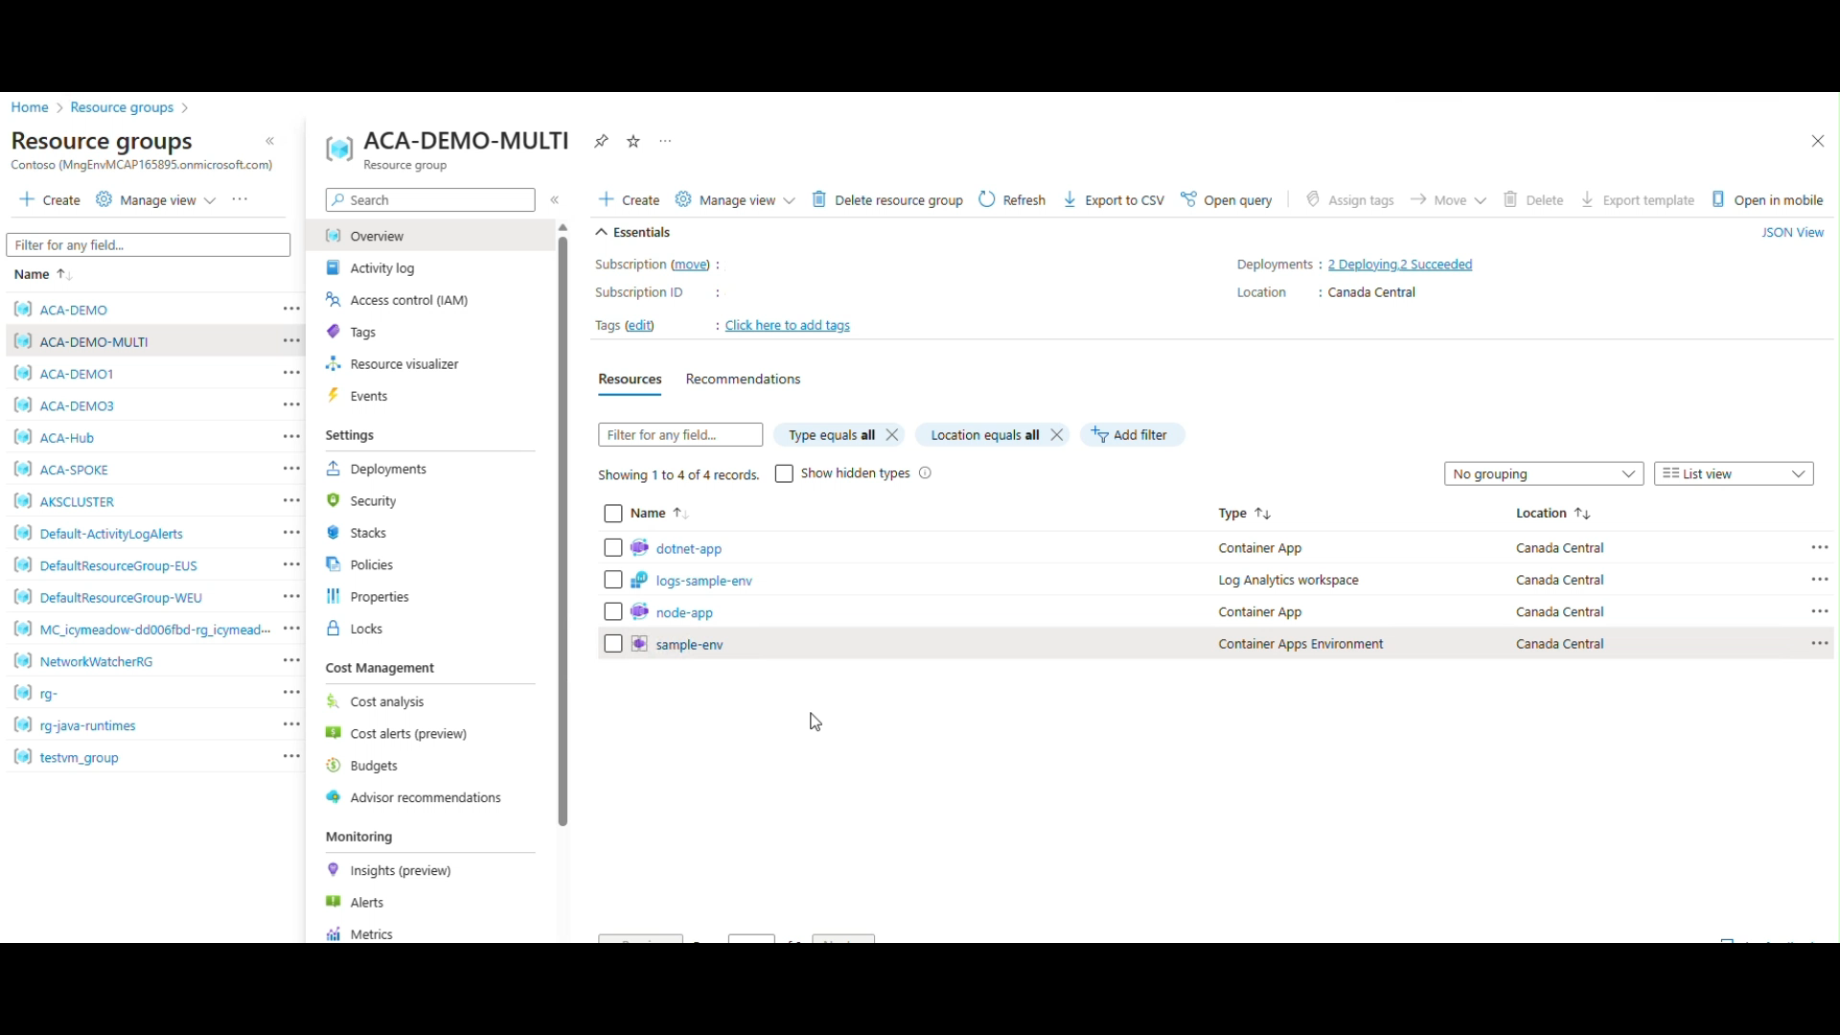
ACA Multi container app communication

Slide 56
Dapr component example
az containerapp env dapr-component set --name ENVIRONMENT_NAME --resource-group RESOURCE_GROUP_NAME --dapr-component-name pubsub --yaml "./pubsub.yaml"
# pubsub.yaml for Azure Service Bus component
componentType: pubsub.azure.servicebus.queue
version: v1
secretStoreComponent: "my-secret-store"
metadata:
- name: connectionString
secretRef: sb-root-connectionstring
scopes:
- publisher-app
- subscriber-app

Slide 57
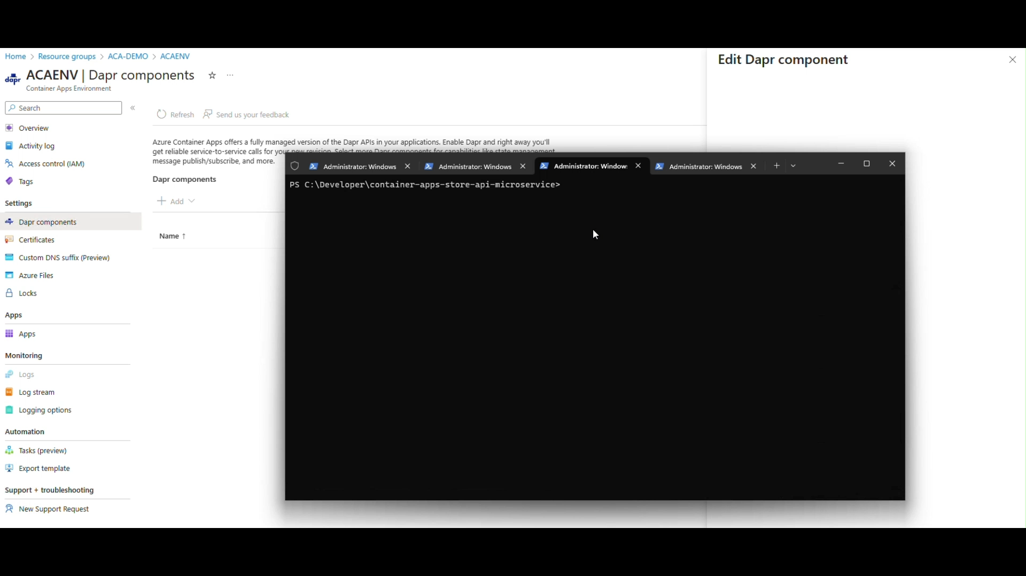
Dapr Component example -Demo

Slide 58
Lab: 2
Exercise 3 - Dapr Integration with ACA
Exercise 4 - ACA State Store With Dapr State Management API

Slide 59
Azure Container Apps Networking & Storage
KEEP
CONTAINERS CALM
AND
PUT IT IN AZURE

Slide 60
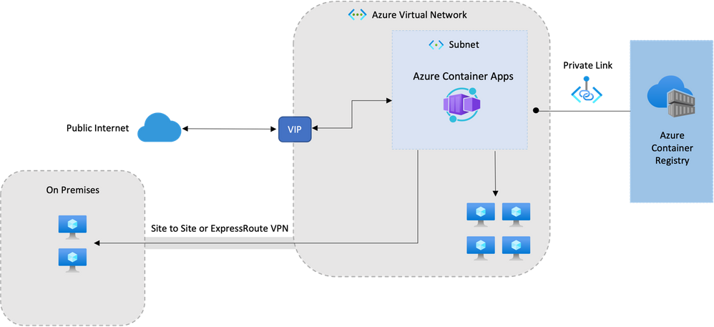
Azure Container Apps Network architecture

Slide 61
Networking architecture in Azure Container Apps
Azure Container Apps run in the context of an environment, which is supported by a virtual network (VNET).
When you create an environment, you can provide a custom VNET, otherwise a VNET is automatically generated for you.
Generated VNETs are inaccessible to you as they're created in Microsoft's tenant.
To take full control over your VNET, provide an existing VNET to Container Apps as you create your environment.

Slide 62
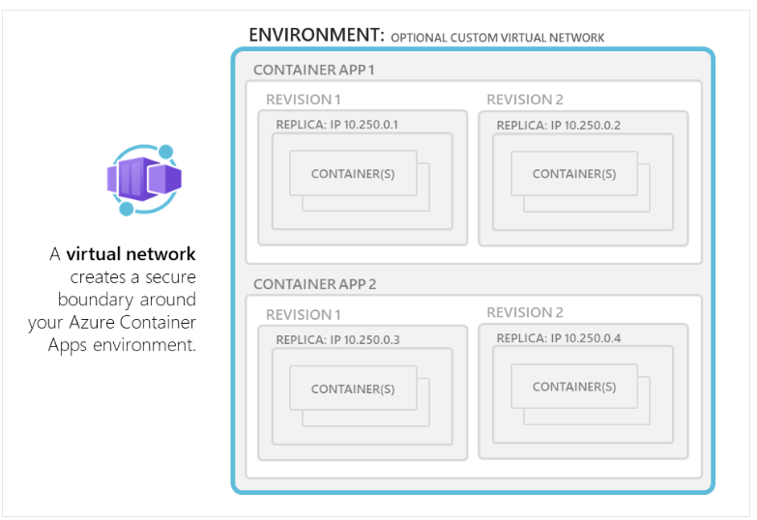
ACA Network architecture
Environment Selection
Consumption only environment
Workload profiles environment (preview)

Slide 63
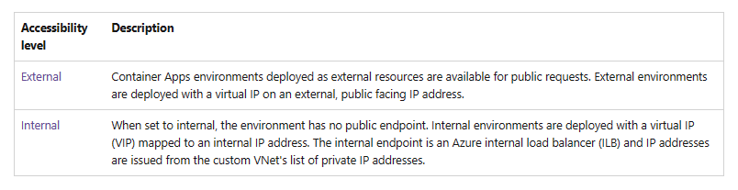
ACA Network architecture
Accessibility Levels
In Container Apps, you can configure whether your container app allows public ingress or only ingress from within your VNet at the environment level.

Slide 64
ACA Network architecture
Custom Vnet configuration
if you want your container app to restrict all outside access, create an internal Container Apps environment.
When you provide your own VNet, you need to provide a subnet that is dedicated to the Container App environment you deploy. This subnet isn't available to other services.
Network addresses are assigned from a subnet range you define as the environment is created.
You can define the subnet range used by the Container Apps environment.
You can restrict inbound requests to the environment exclusively to the VNet by deploying the environment as internal.

Slide 65
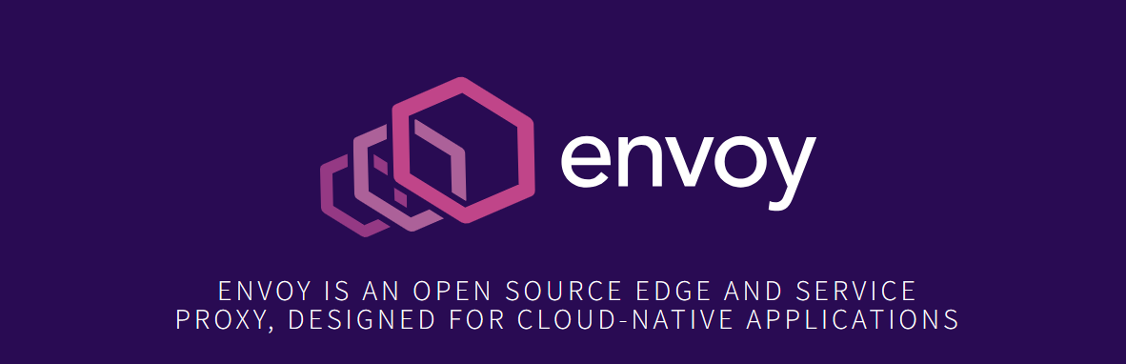
ACA Network architecture
HTTP edge proxy behavior
Envoy Proxy - Home
Azure Container Apps uses Envoy proxy as an edge HTTP proxy. TLS is terminated on the edge and requests are routed based on their traffic splitting rules and routes traffic to the correct application.

Slide 66
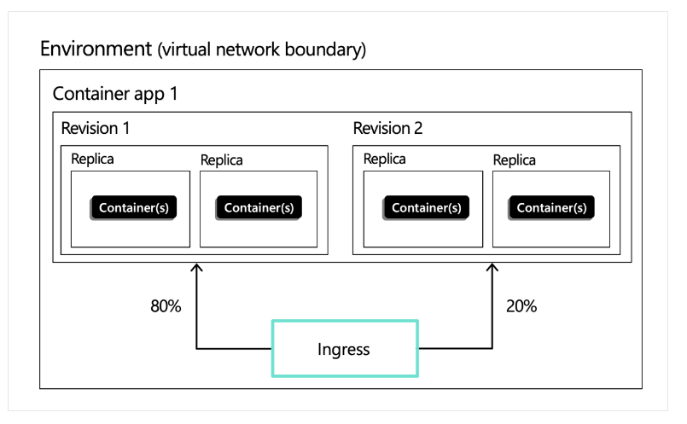
Ingress in Azure Container Apps
External: Accepts traffic from both the public internet and your container app's internal environment.
Internal: Allows only internal access from within your container app's environment.

Slide 67
Ingress in Azure Container Apps
Protocol types
Container Apps supports two protocols for ingress: HTTP and TCP.
HTTP
With HTTP ingress enabled, container app has:
Support for TLS termination
Support for HTTP/1.1 and HTTP/2
Support for WebSocket and gRPC
HTTPS endpoints that always use TLS 1.2, terminated at the ingress point
Endpoints that expose ports 80 (for HTTP) and 443 (for HTTPS)
By default, HTTP requests to port 80 are automatically redirected to HTTPS on 443
A fully qualified domain name (FQDN)
Request timeout is 240 seconds

Slide 68
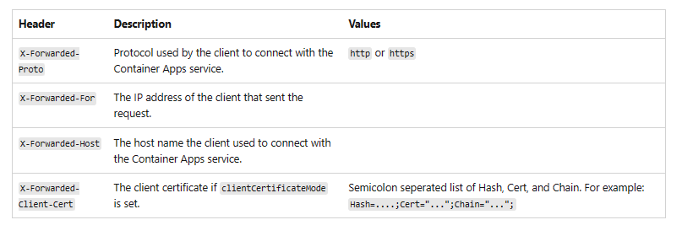
Ingress in Azure Container Apps
HTTP headers
HTTP ingress adds headers to pass metadata about the client request to your container app

Slide 69
Ingress in Azure Container Apps
Accessibility level:
You can set your container app as externally or internally accessible in the environment.
An environment variable CONTAINER_APP_ENV_DNS_SUFFIX is used to automatically resolve the FQDN suffix for your environment.
When communicating between Container Apps within the same environment, you may also use the app name.
Traffic split rules:
You can define traffic splitting rules between different revisions of your application.

Slide 70
Scenarios
Rapid iteration
In situations where you're frequently iterating development of your container app, you can set traffic rules to always shift all traffic to the latest deployed revision.
The following example routes all traffic to the latest deployed revision:
"ingress": {
"traffic": [
{
"latestRevision": true,
"weight": 100
}
]
}

Slide 71
Scenarios
Once you're satisfied with the latest revision, you can lock traffic to that revision by updating the ingress settings to:
"ingress": {
"traffic": [
{
"latestRevision": false, // optional
"revisionName": "myapp--knowngoodrevision",
"weight": 100
}
]
}

Slide 72
Update existing revision
Consider a situation where you have a known good revision that's serving 100% of your traffic, but you want to issue an update to your app. You can deploy and test new revisions using their direct endpoints without affecting the main revision serving the app.
Once you're satisfied with the updated revision, you can shift a portion of traffic to the new revision for testing and verification.
The following configuration demonstrates how to move 20% of traffic over to the updated revision:
"ingress": {
"traffic": [
{
"revisionName": "myapp--knowngoodrevision",
"weight": 80
},
{
"revisionName": "myapp--newerrevision",
"weight": 20
}
]
}

Slide 73
Staging microservices
When building microservices, you may want to maintain production and staging endpoints for the same app. Use labels to ensure that traffic doesn't switch between different revisions.
The following example demonstrates how to apply labels to different revisions.
"ingress": {
"traffic": [
{
"revisionName": "myapp--knowngoodrevision",
"weight": 100
},
{
"revisionName": "myapp--98fdgt",
"weight": 0,
"label": "staging"
}
]
}

Slide 74
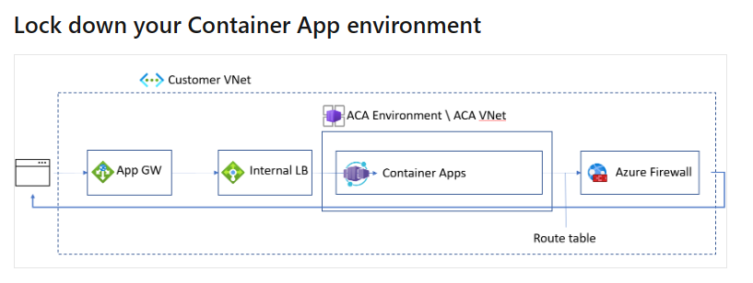
Locking down Container app environment
Create your internal container app environment on the workload profiles environment.
Integrate your Container Apps with an Application Gateway.
Configure UDR to route all traffic through Azure Firewall.

Slide 75
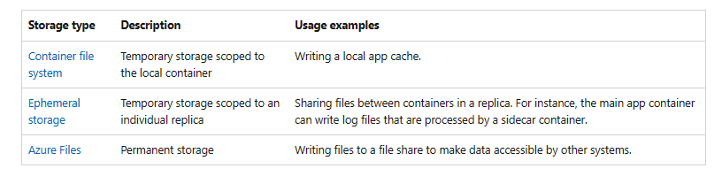
Storage configuration for ACA
A container app has access to different types of storage. A single app can take advantage of more than one type of storage if necessary.

Slide 76
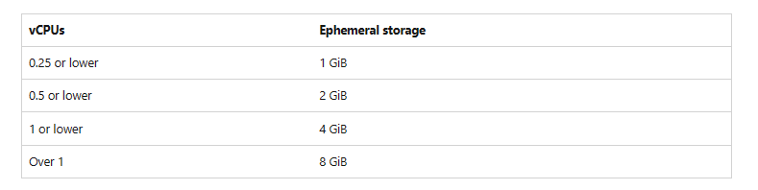
Storage for ACA
Ephemeral volume
Ephemeral storage is scoped to a single replica.
Files are persisted for the lifetime of the replica.
If a container in a replica restarts, the files in the volume remain.
Any containers in the replica can mount the same volume.
A container can mount multiple ephemeral volumes.
The available storage depends on the total amount of vCPUs allocated to the replica.
To configure ephemeral storage, first define an EmptyDir volume in the revision. Then define a volume mount in one or more containers in the revision.

Slide 77
Lab: 3
Exercise 5 - ACA Async Communication with Dapr Pub/Sub API
Exercise 6 - ACA with Dapr Bindings Building Block
Exercise 7 - ACA Scheduled Jobs with Dapr Cron Binding

Slide 78
KEEP
CONTAINERS CALM
AND
PUT IT IN AZURE
Observability with
Container Apps

Slide 79
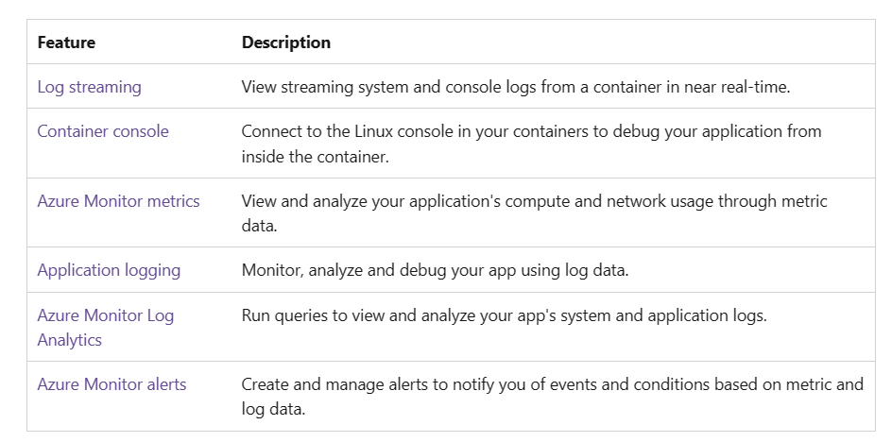
Observability in Container Apps
Azure Container Apps provides several built-in observability features that together give you a holistic view of your container app’s health throughout its application lifecycle
These features help in monitoring and diagnosing the state of application to improve performance and respond to trends and critical problems.

Slide 80
Application lifecycle observability
Development and test
During the development and test phase, real-time access to containers' application logs and console is critical for debugging issues. Container Apps provides:
Log streaming: View real-time log streams from your containers.
Container console: Access the container console to debug your application.
Deployment
After deploying the container app, continuous monitoring helps in quickly identifying the problems that may occur around error rates, performance, and resource consumption.
Azure Monitor metrics: Monitor and analyze key metrics.
Azure Monitor alerts: Receive alerts for critical conditions.
Azure Monitor Log Analytics: View and analyze application logs.
Maintenance
Container Apps manages updates to your container app by creating revisions. You can run multiple revisions concurrently in blue green deployments or to perform A/B testing.
These observability features will help monitoring applications across revisions:
Azure Monitor metrics: Monitor and compare key metrics for multiple revisions.
Azure Monitor alerts: Receive individual alerts per revision.
Azure Monitor Log Analytics: View, analyze and compare log data for multiple revisions.

Slide 81
Lab: 4
Exercise 8 - ACA Monitoring and Observability with Application Insights

Slide 82
Authentication and Disaster Recovery with
Container Apps
KEEP
CONTAINERS CALM
AND
PUT IT IN AZURE

Slide 83
Authentication and authorization with Azure Container Apps
Built authentication
Identity Providers
Consideration for using built in authentication
Feature architecture
Customize sign in and sign out
Access user claims in application code

Slide 84
Authentication and authorization with Azure Container Apps
Built in authentication : Why Built in authentication ?
Identity providers
Entra ID
Facebook
GitHub
Google
Twitter
Custom OpenID Connect

Slide 85
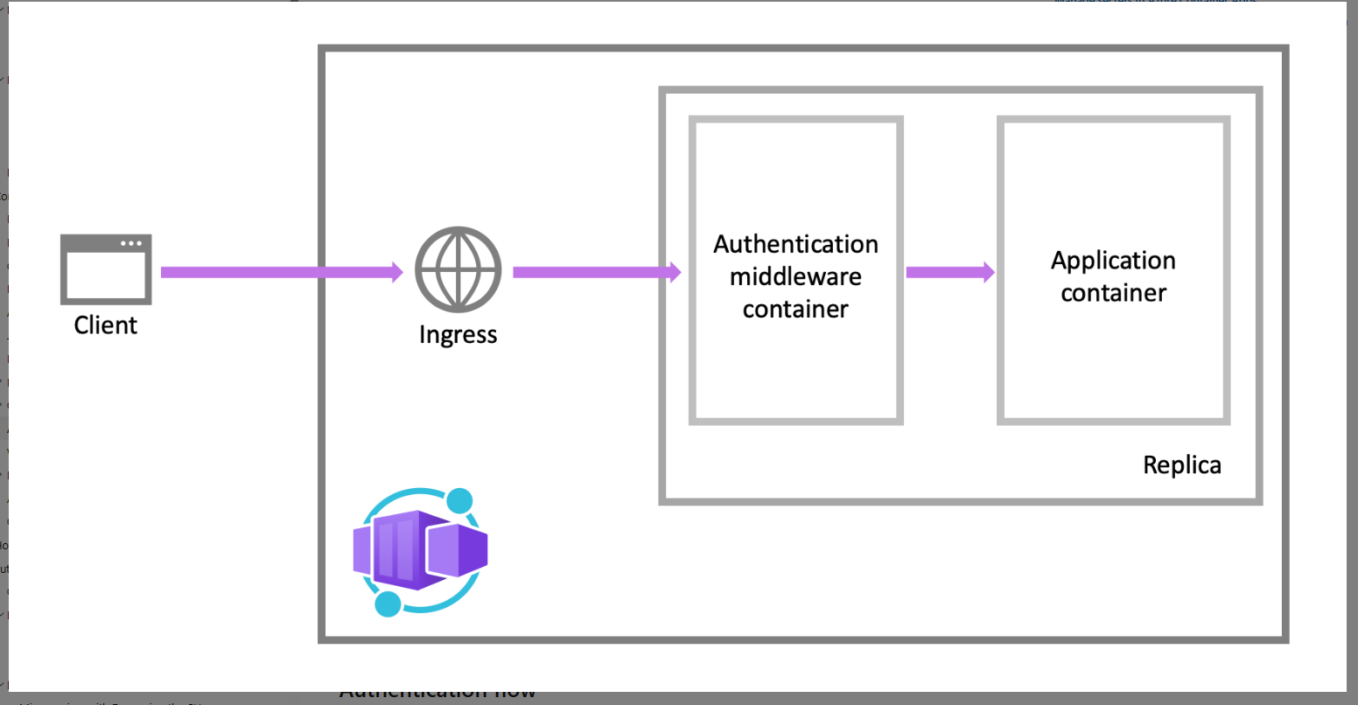
Authentication architecture

Slide 86

Disaster Recovery
options
with
Azure
Container Apps

Slide 87

Disaster Recovery options with Azure Container Apps
Regional Support
ACR Availability Zones are supported in the following regions:

Slide 88
Disaster Recovery options with Azure Container Apps
Region conversions to availability zones aren't currently supported.
To enable availability zone support in a region, create the registry in the desired region with availability zone support enabled, or add a replicated region with availability zone support enabled.
A registry with an AZ-enabled stamp creates a home region replication with an AZ-enabled stamp by default. The AZ stamp can't be disabled once it's enabled.
The home region replication represents the home region registry. It helps to view and manage the availability zone properties and can't be deleted.
The availability zone is per region, once the replications are created, their states can't be changed, except by deleting and re-creating the replications.
Zone redundancy can't be disabled in a region.
ACR Tasks doesn't yet support availability zones.

Slide 89
KEEP
CONTAINERS CALM
AND
PUT IT IN AZURE
Understanding KEDA

Slide 90

Kubernetes Event-Driven Autoscaling (KEDA)
Kubernetes Event-driven Autoscaling (KEDA) is a single-purpose and lightweight component that strives to make application autoscaling simple and is a CNCF Incubation project.
It applies event-driven autoscaling to scale your application to meet demand in a sustainable and cost-efficient manner with scale-to-zero.

Slide 91
Scaling
KEDA
HTTP
Event-driven
CPU
Memory
{
"name": "http-rule",
"http": {
"metadata": {
"concurrentRequests": 50
}
}
}
artemis-queue, kafka, aws-cloudwatch, aws-kinesis-stream, aws-sqs-queue, azure-blob, azure-eventhub, azure-servicebus, azure-queue, cron, external, gcp-pubsub, huawei-cloudeye, ibmmq, influxdb, mongodb, mssql, mysql, postgresql, rabbitmq, redis, redis-streams, selenium-grid, solace-event-queue, ..
{
"name": "cpu-rule",
"custom": {
"type": "cpu",
"metadata": {
"type": "Utilization",
"value": "50"
}
}
}
{
"name": "mem-rule",
"custom": {
"type": "memory",
"metadata": {
"type": "AverageValue",
"value": "512"
}
}
}
Support for scale to zero and specifying minimum/maximum replicas
Support for specifying minimum/maximum replicas

Slide 92
Lab: 5
Excercise 9 - ACA Auto Scaling with KEDA

Slide 93
DevOps Integration with Container Apps
KEEP
CONTAINERS CALM
AND
PUT IT IN AZURE

Slide 94

Deploy to Azure Container Apps with GitHub Actions
Build from a Dockerfile and deploy to Container Apps
Build from source code without a Dockerfile and deploy to Container Apps. Supported languages include .NET, Node.js, PHP, Python, and Ruby
Deploy an existing container image to Container Apps

Slide 95
Deploy to Azure Container Apps from Azure Pipelines
Azure Repos - Azure Repos is a set of version control tools that you can use to manage your code.
Git: distributed version control
Team Foundation Version Control (TFVC): centralized version control
Container Apps Azure Pipelines task
The task supports the following scenarios:
Build from a Dockerfile and deploy to Container Apps
Build from source code without a Dockerfile and deploy to Container Apps. Supported languages include .NET, Node.js, PHP, Python, and Ruby
Deploy an existing container image to Container Apps

Slide 96
Azure Landing Zone for Container Apps
KEEP
CONTAINERS CALM
AND
PUT IT IN AZURE

Slide 97

Azure Landing Zone architecture
An Azure landing zone is an environment that follows key design principles across eight design areas.
These design principles accommodate all application portfolios and enable application migration, modernization, and innovation at scale.

Slide 98

Azure Container Apps Landing Zone accelerator

Slide 99

Reference secrets from Azure Key Vault
When you define a secret, you create a reference to a secret stored in Azure Key Vault. Container Apps automatically retrieves the secret value from Key Vault and makes it available as a secret in your container app.

Slide 100
Lab: 7
Excercise 11 - Integration with Azure Container Apps landing zone accelerator

Slide 101
Get started with Azure Container Apps today!
https://aka.ms/containerapps

